Slide 1
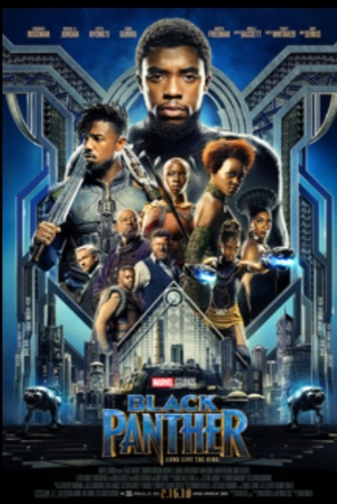
AN ANALYSIS OF TWITTER’S PERCEPTION ABOUT THE MOVIE
BLACK PANTHER 18
BY:
RASHID FUSEINI
28-SEPTEMBER-2023

Slide 2
Table of Contents
Introduction
Objective
Business Use Case
Analysis Approach
Key Findings
Conclusion
Appendix

Slide 3
Introduction
Black panther is a 2018 American superhero film based on the marvel comics character of the same name. It was produced by Marvel Studios and distributed by Walt Disney Studios Motion Pictures. It has since made waves on social media platforms especially Twitter and Instagram.
Black Panther, Eric Killmonger, Nakia, Okoye, Shuri, Zuri, Ramonda and M’Baku are the major characters of the film.

Slide 4
Objectives
The analysis was carried out to show Twitter’s perception about the film.
The goal was to find out;
General sentiment about the film.
Top 20 most viewed countries.
The most talked about cast.
How the film conversation generally fared on twitter.

Slide 5
Use Case
This analysis can be use by any company with social media presence to predict customers sentiment (i.e. whether their customers are happy or not) about a product or service.
The process could be done automatically with data analytics without having humans manually review thousands of tweets and customer reviews

Slide 6
Analysis Approach
Objective
Have a good understanding of the data and business objectives about project
Data Preparation
Performed data cleaning, removed duplicate entries, etc.
Analysis
I used natural language processing tools such as nltk and Vader intensity analyzer to determine positive, negative and neutral texts for the analysis
Conclusion
Conclude on findings
Key findings
Results were presented in charts and a dashboard using Microsoft power bi to show key findings.

Slide 7
KEY FINDINGS

Slide 8
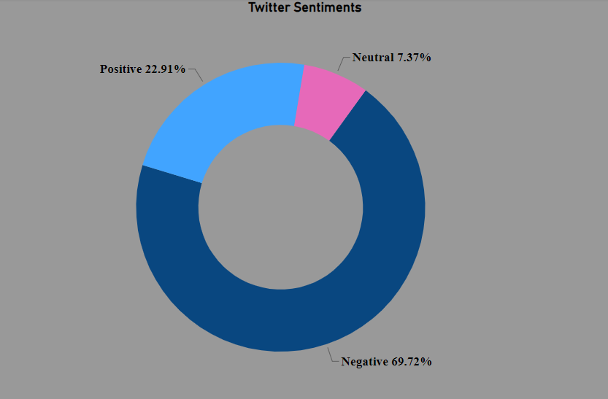
Viewers Sentiment About The Film
From my analysis of twitter’s perception about the film, 69.72% of the total population commented negatively, 22.91% commented positively and 7.37% commented neutrally about the film.
Therefore with regards to this analysis, it can be concluded that majority of twitter commented negatively about the film.

Slide 9
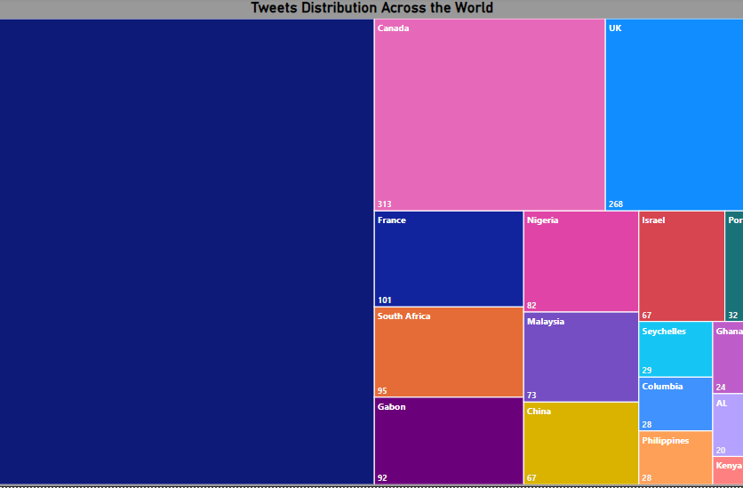
Top 20 Most Viewed Countries
Out of the top 20 most viewed countries, USA has the most tweets, followed by Canada, UK and Israel being the least.

Slide 10
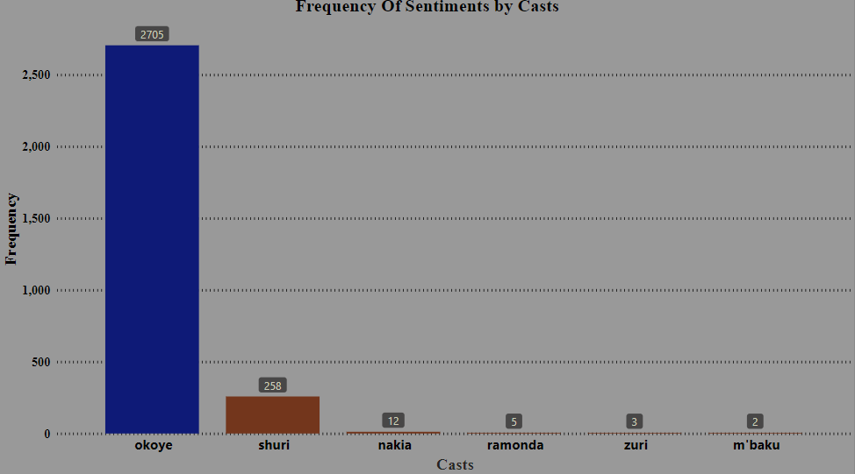
Viewers Sentiment About The Most Talked About Cast
Okoye is the most talked about cast with a frequency of 2705 followed by Shuri with a frequency of 258 and m’baku being the least talked about cast with a total frequency of 2
It shouldn’t be a surprise that, Okoye was the most talked about cast due to the role she played in the film

Slide 11
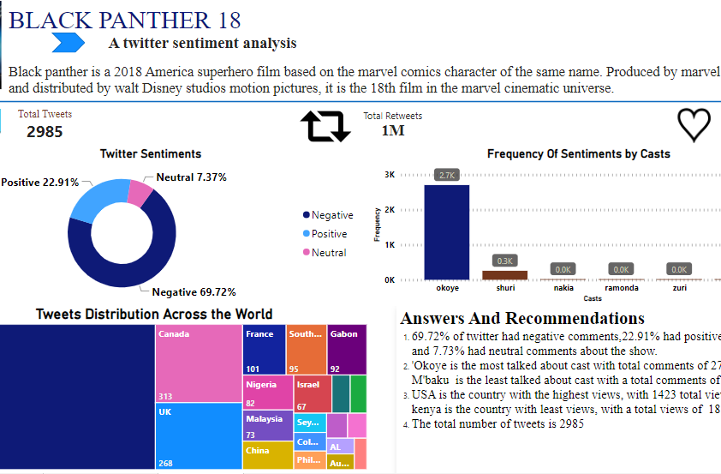
A Comprehensive Microsoft Power BI Dashboard

Slide 12
Conclusion
Generally, majority of the twitter commented negatively about the film and this may be as the result of the sentiment of the most talked about cast.
Majority of twitter commented negatively about Okoye, who is the most talked about cast and this is as the result of the role she played in the movie.
Also, it shouldn’t be a shock that USA is the country with most tweets, since it is the host country and it is only fair that most tweets would come from USA.

